Slide 1


SE-Mini Project
By:
Karthi Devendra
Udit Mahajan
Nitish Wadpally
Mark John
“Real-Time Web Chat Application”
Mentor
Prof. Snehal Andhare

Slide 2

Introduction
Teleconferencing or chatting, is a method of using technology to bring people and “ideas” together despite of geographical barriers. This chat application is created with the mind set to not just be another chat application but to add a level of clean UI (user interface) or a solid app structure function over a secure broadcast network. It is an effort for a more modern approach to internet security on a communication medium. The design of the UI (user interface) is greatly influenced by the already exiting Chat Applications so as to give its users a fresh but familiar UI (user interface) design.

Slide 3
Key Features:
TWO
It can be used for sending & receiving text messages in real time and it supports user authentication by allowing the user to send, accept and decline friend requests.
ONE
We have built a social-networking tool that leverages on technology advancement thereby allowing its users to communicate in real time. It makes efforts to enhance user experience of using application.
THREE
It offers the user a feature to perform both private chats and group chats with the other users.

Slide 4

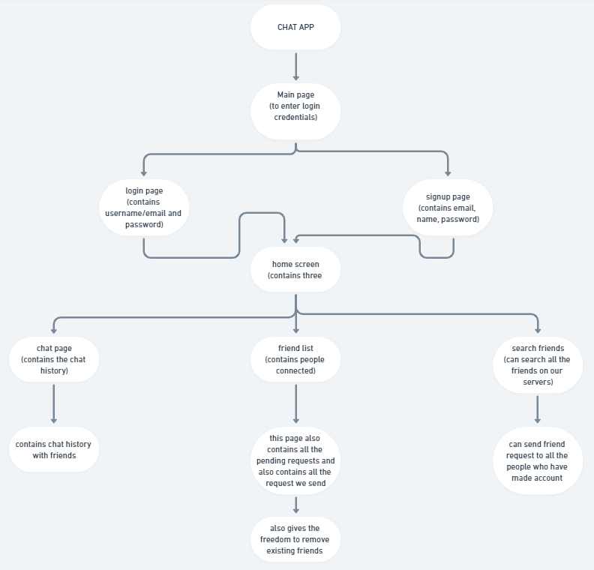
Basic Functioning of the application: (Flow Chart)

Slide 5
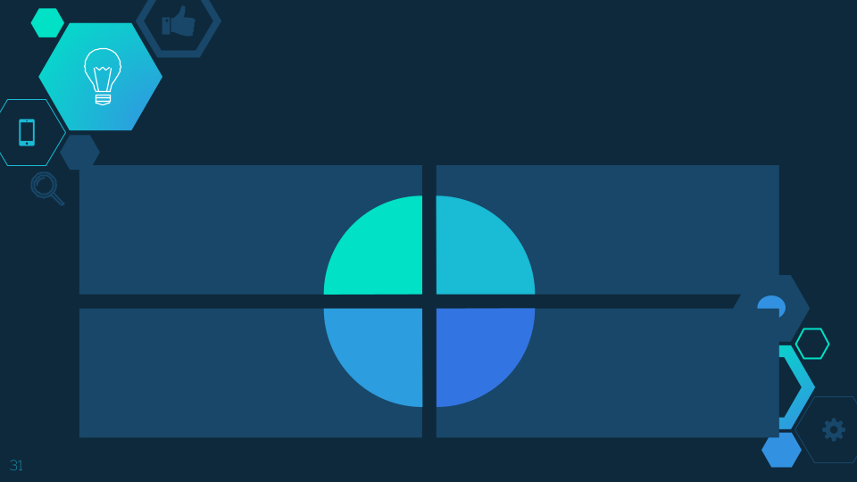
Concepts used in frontend:
HTML is a robust framework for developing and designing web applications. The main pillars include CSS and Javascript
APIs together.
Bootstrap is a framework to help us
design websites faster and easier. It
includes HTML and CSS based design
templates. Bootstrap's responsive
CSS adjusts to phones, tablets,
and desktops.
Html
Css
Vanilla Javascript &
JS libraries: ajax*, jquery**.
Java Script
For future evolvement
of our project we may learn about React Js
for better results.
Others
*Ajax is short form of Asynchronous Javascript and XML which allows execution of the Javascript without reloading the complete web page. It sends and receives only a portion of the web page.
**jQuery makes it much easier to use JavaScript on our website & takes a lot of common tasks that require many lines of JavaScript code and wraps them into methods that you can call with a single line of code.

Slide 6
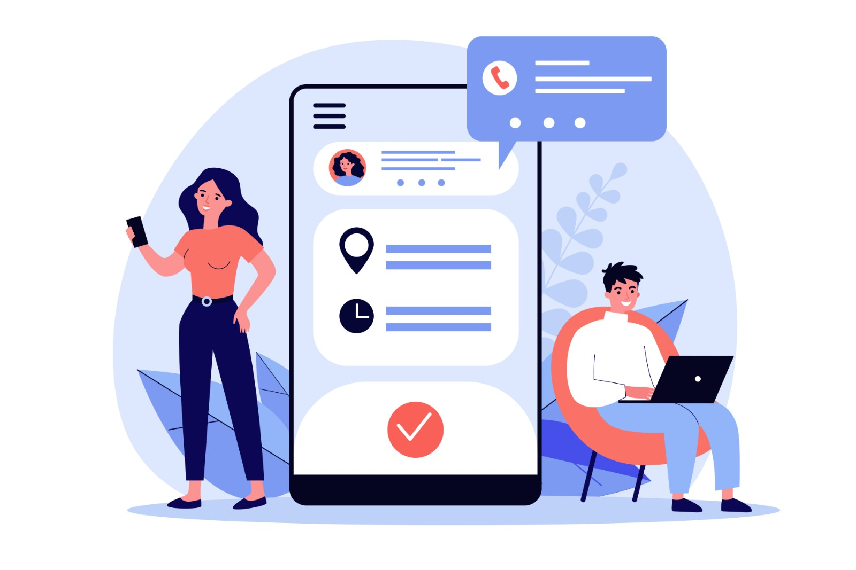
Concepts used in backend:
Django is a high-level Python web framework that enables rapid development of secure and maintainable websites. It allows developers to use modules for faster development.
Channels is used to make Django able to handle more than just plain HTTP
requests, including WebSockets, as
well as the ability to run code after
a response has been sent for
things like background calculation.
Python-Django
Channels
Postgres is object-relational database management system that allows us to store large and sophisticated data safely & to
run administrative tasks
and create integral
Postgres-
SQL
Web-
sockets
Helps in dynamic flow of the connections that are persistent to the communication from both the ends with considerable
fast speed.
environments.

Slide 7
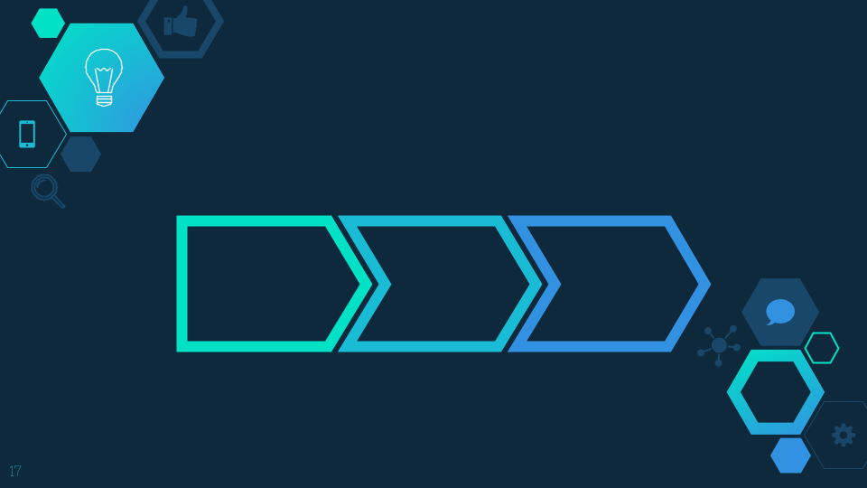
Modules Used:
It’s objective is to manage the chat history. This chat history module is an important module in this project. All the chat history is managed by the admin and chat user will also be able to see their personal chat history.
It’s objective is to provide all the functionality related to the chat user. It tracks all the information of the chat user. We have developed all type of CRUD (Create, Read, Update and Delete) operations on the chat user.
Chat User
Module
Chat Profile
Module
Chat History
Module
The objective of developing this module is to manage the chat profile data wise. So, all chat profiles will be allowed to accept or reject the request sent to them on the application. They can see the list of all added chat profiles and filter it accordingly.

Slide 8
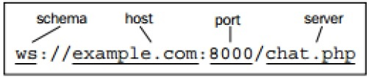
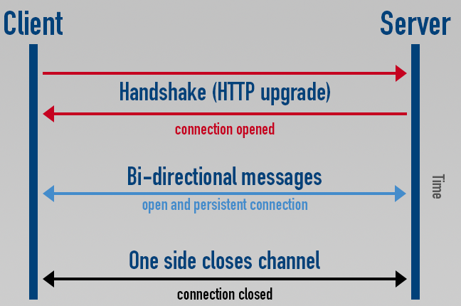
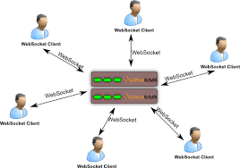
Client-Server Model & Socket Programming:
Web sockets are defined as a two-way communication between the servers and the clients, which mean both the parties communicate and exchange data at the same time.
The key points of Web Sockets are true concurrency and optimization of performance, resulting in more responsive and rich web applications.

Slide 9
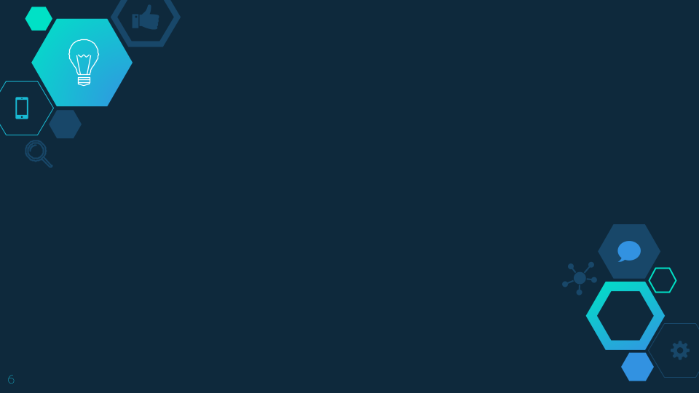
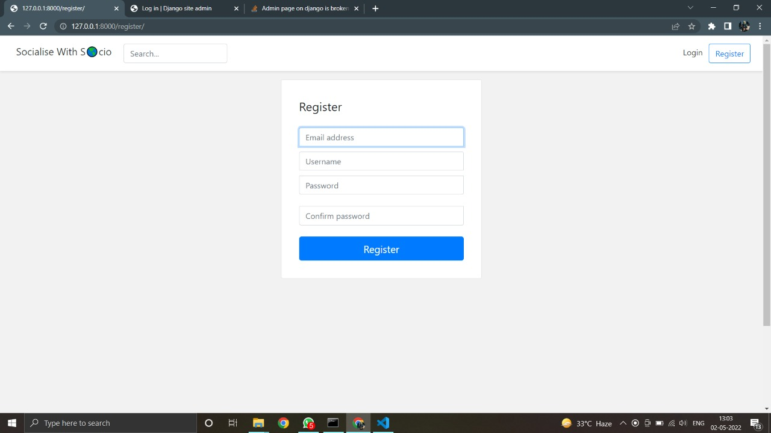
Register/login Page:

Slide 10
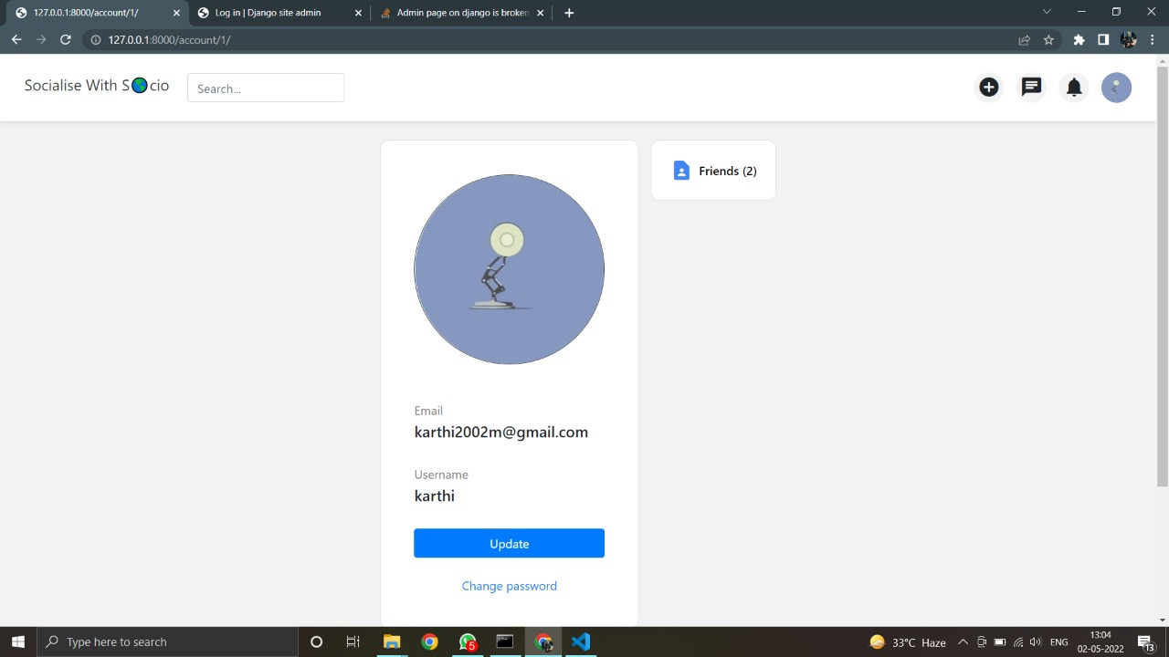
Profile Change:

Slide 11
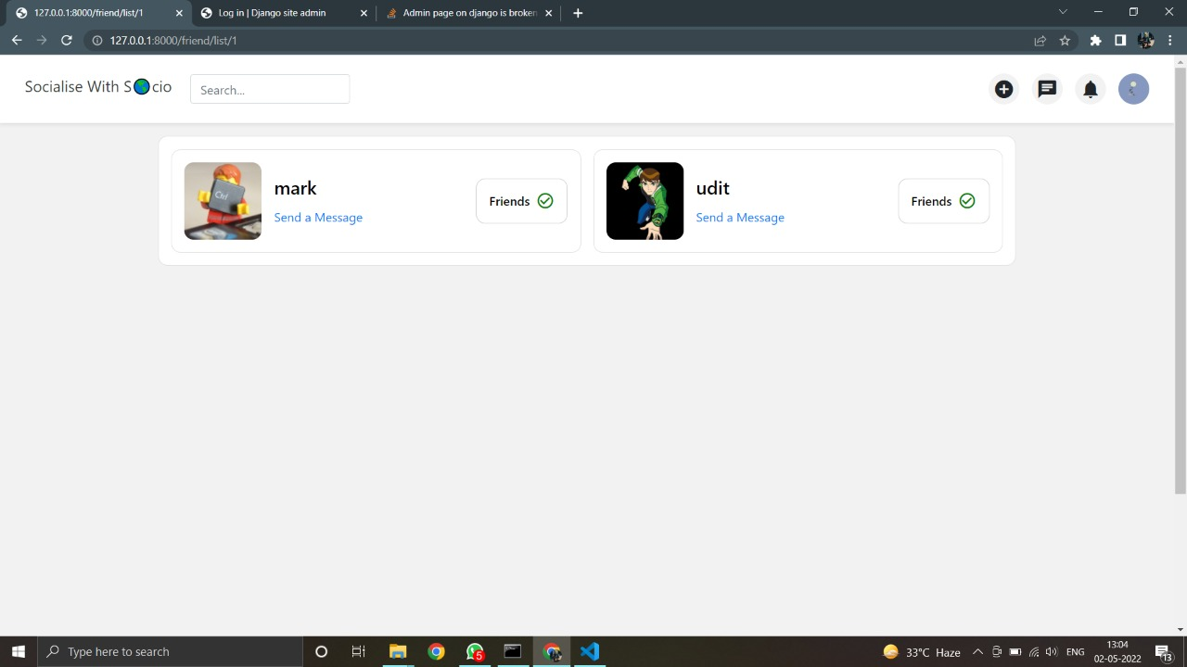
Friend list:

Slide 12
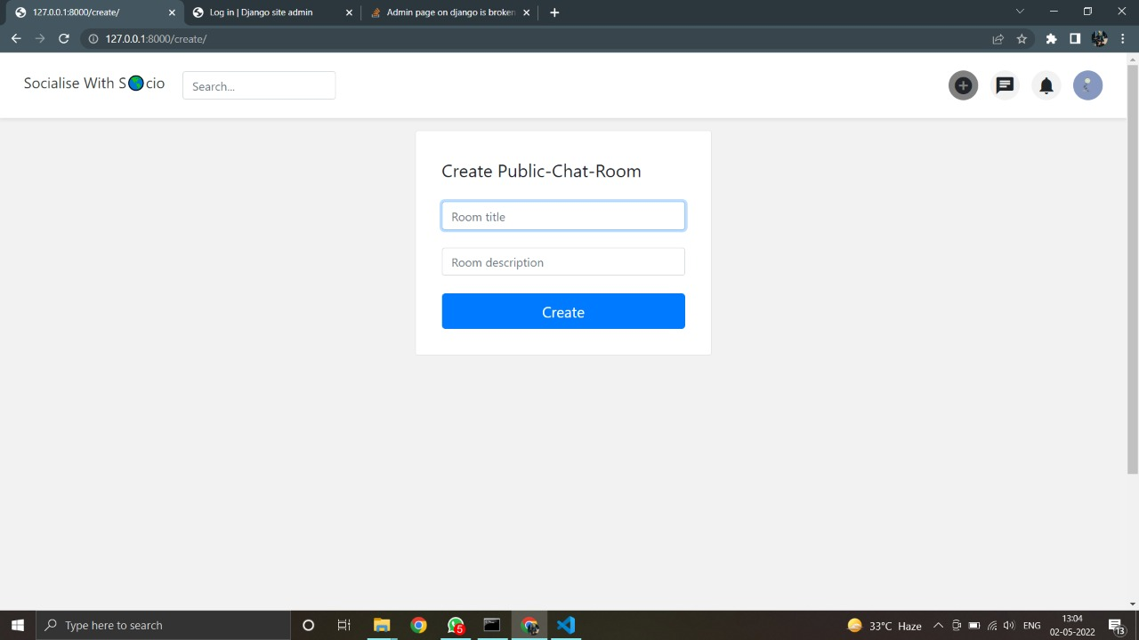
Creating a public chatroom:

Slide 13
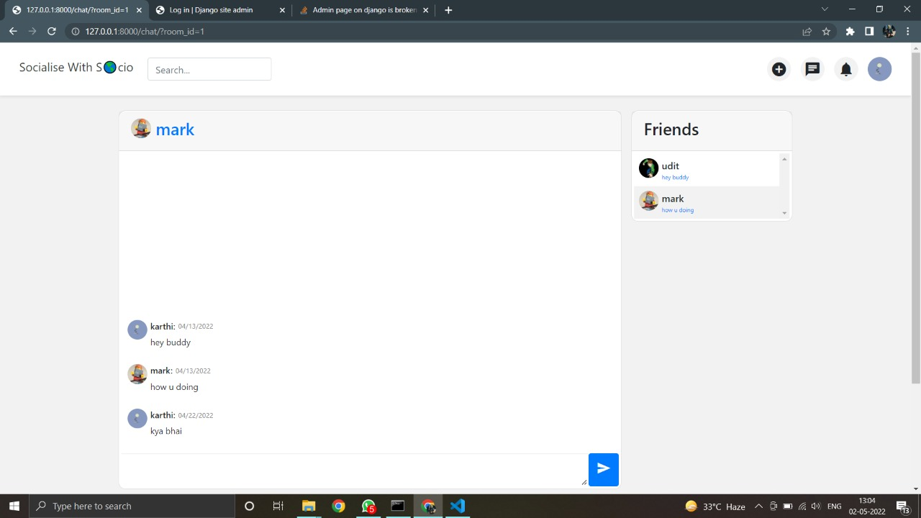
UI for Chatting interface:

Slide 14
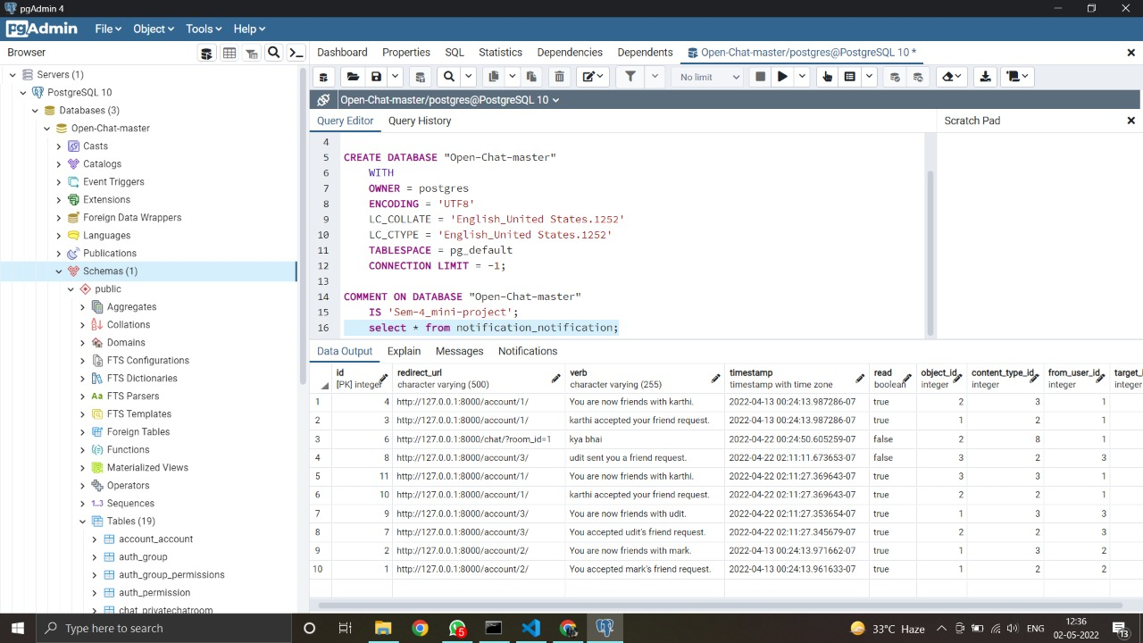
Database Connectivity:

Slide 15
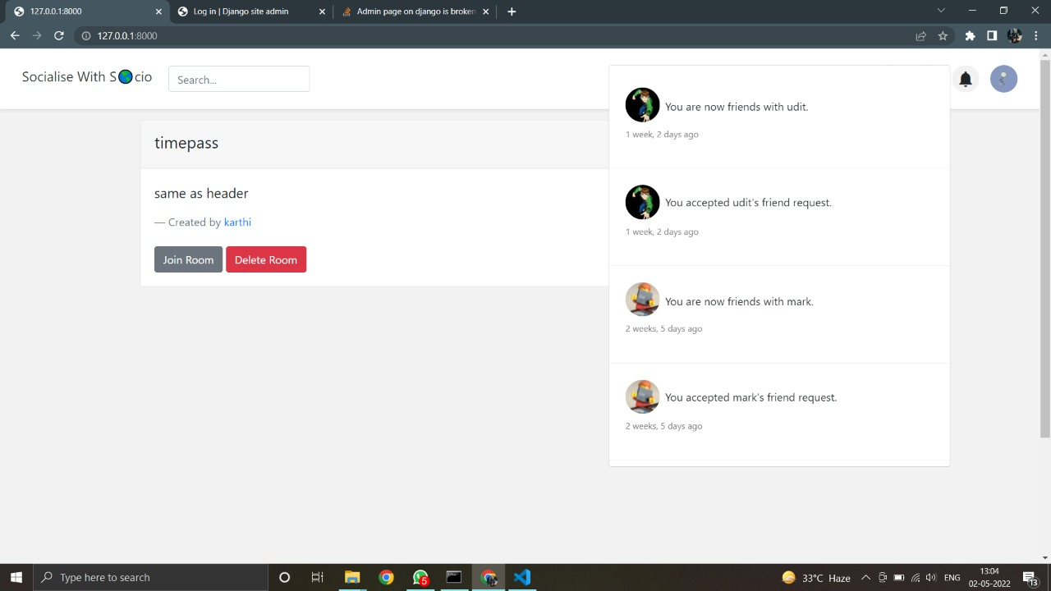
Instant Notifications:

Slide 16
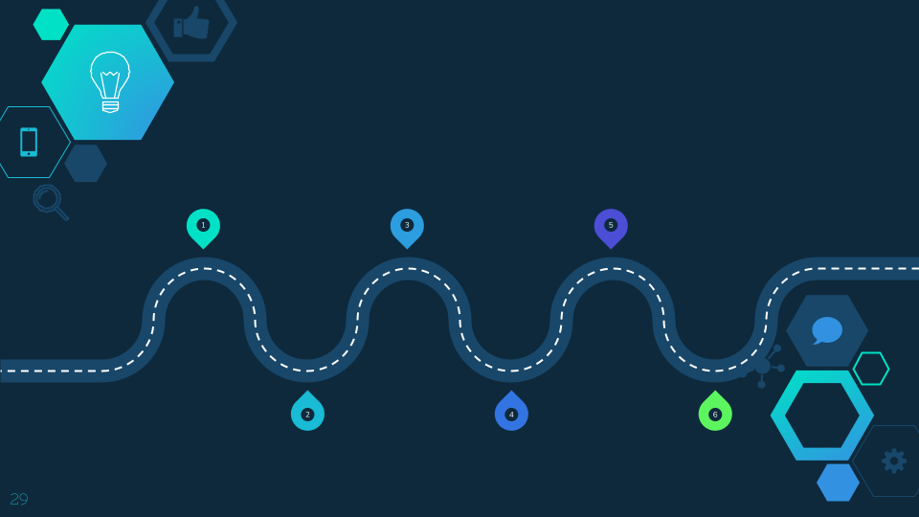
Future Scope:
In future, our
project will evolve for placing voice messages, sharing updates, videos & photos and potentially for sharing locations and even making monetary financial transactions.
It’s scope of utility can go beyond exchanging texts, picture and videos. It can also include corporate accounts, browsers, chat bots, and payment methods as well in future.
It also has a potential of
evolving as a multi-functional app used for doing e-commerce, accessing fintech applications, playing games
or even connecting to diverse IoT devices.
Privacy is going to be the one of most important part adding to its future scope and it will be the key deciding factor of the economical value of this project in coming times.
The scope of chat
applications can go beyond individual users to businesses to deliver automated interactive experiences, e-commerce guidance and customer support with the help of chat-bots.
VR could also be applied to it’s utilities through a feature where people can upload their own pictures or selfies with Augmented reality filters & can view their friends and family pictures in a separate section.

Slide 17
Thank You….

